Slide 1
CREATE YOUR OWN REALITY; INTEGRATING A-FRAME CURRICULUM WITH THE PLTW CS PATHWAY HTTPS://TINYURL.COM/PLTWVRSESSION
Katie Cunningham | PLTW CSE & CSP Certified Instructor

Slide 2
INTRODUCTION
Who?
Blackstone valley Tech Information Tech & Networking Team Leader
Skills USA- Occupational Trades B Series Director
PLTW- CSE and CSP Certified Instructor
What?
A- Frame Web Virtual Reality
Basic rundown of use
Tools/ Projects for students
Integration into PLTW Curriculum
Why?
Promote High Quality student work
Student creativity
Expansion of skills

Slide 3
RESOURCES NEEDED
Laptop
Phone (Apple or Android)
Internet Access
WPI- Open, go to http://guest.wpi.edu, I have a guest pass
Username: PLTW_Conf_2019
Password: 414450
Github Account

Slide 4
BASIC OVERVIEW

Slide 5
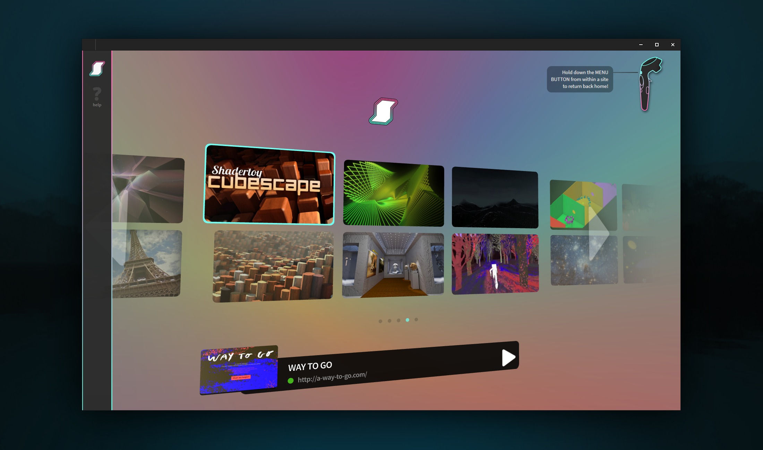
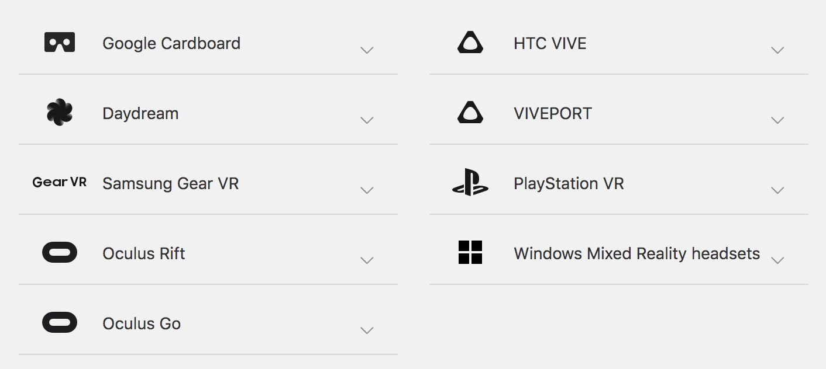
WHAT IS WEB VR?
WebVR is an open specification that makes it possible to experience VR in your browser using many different types of devices.
Firefox
Supermedium Browser
Chrome for Android
Notes:
Allows you to use vr in a standard web browser. By standard web browser I mean google chrome,

Slide 6
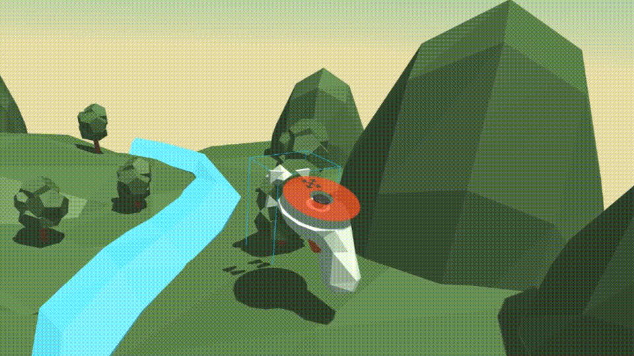
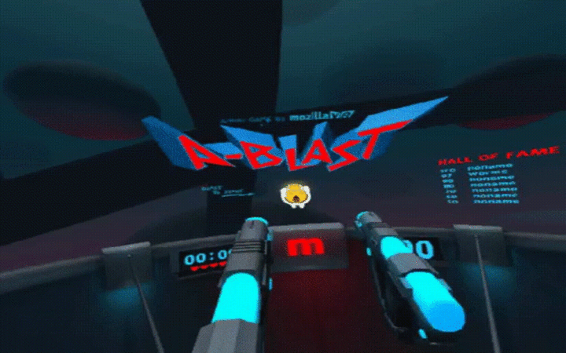
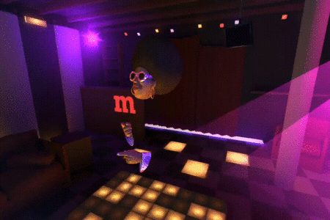
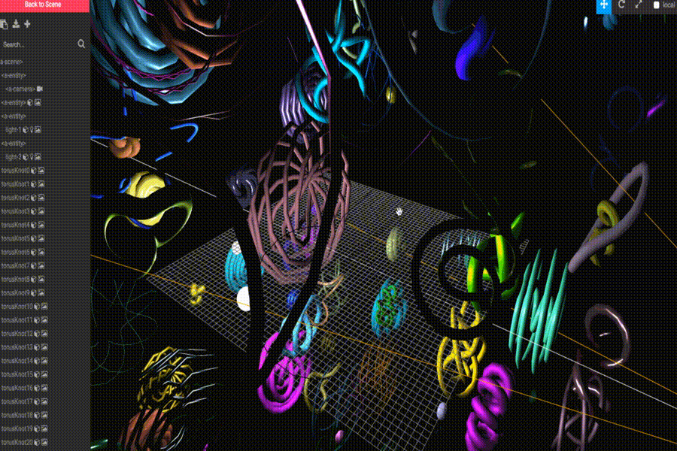
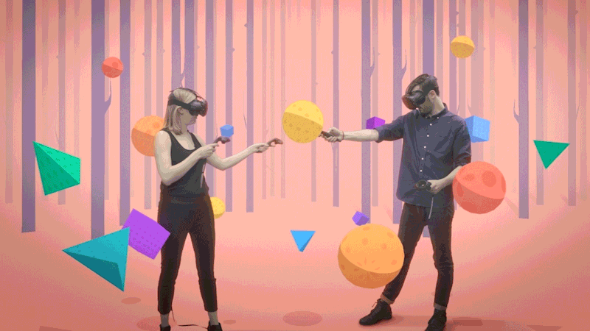
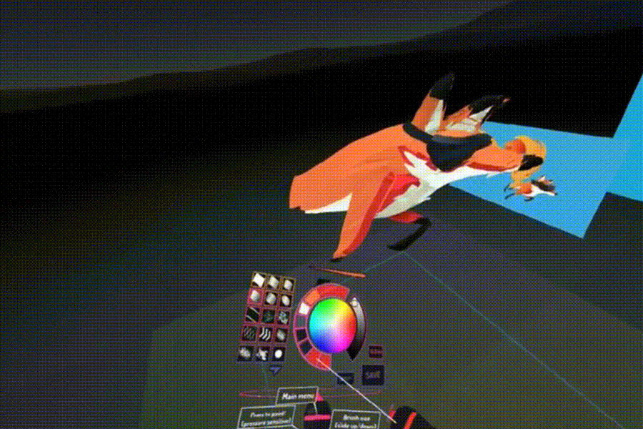
WHAT IS A-FRAME?
A-Frame is a web framework for building virtual reality (VR) experiences
A-Frame is a three.js framework with an entity-component-system (ECS) architecture.
based on top of HTML
a entity-component framework that provides a declarative, extensible, and composable structure to three.js
An independent open-source project available on a wide variety of devices
Notes:
Three js- a cross browser js library and api that enables 3d graphics in a browser

Slide 7
FEATURES OF A-FRAME
Simple: No install, runs on web-based platform, glitch
Declarative HTML: uses an entity based structure that is easy to read and manage for all users
Cross-Platform VR: Supports controllers for Vive , Rift, Windows Mixed Reality, Daydream, Gear VR and Google Cardboard.
Visual Inspector: Similar design to Unity provides visual inspector of integrated components.

Slide 8
USING A-FRAME
Glitch (preferred platform)
Integrates with repos on github
Supported Browsers: Supermedium or Exokit; Full List of supported browsers here
Supports existing libraries: React, Vue.js, Angular, d3.js, and jQuery
Easier to grasp than 2D HTML, entity based
Notes:
Entities vs elements

Slide 9
PRIMITIVES
Elements that wrap an entity components properties (similar to a Div or HTML element)
Predefined initial values
Create meshes, 360 degree camera views, custom environment and perspective objects
Predefined or user can create own

Slide 10
INTRODUCING A-FRAME; HTML OVERVIEW
<head> section
The <head> section defines some meta information about the web page like the title and the type of content.
Essentially all the information you want to use alongside your page, but not have shown to the user
The <script> tag loads the javascript code that enables the A-Frame engine.
All of your A-Frame programs must include this <script> tag
<body> section
The <body> section is where the game assets are defined and placed on the webpage.
Arranged in a hierarchical structure
whatever tag is opened first must close last (stacking dolls)
<a-scene> tag
defines the scene; assets that should be displayed in the scene are included as children of the this tag.

Slide 11
HEAD SECTION
The <head> section defines some meta information about the web page like the title and the type of content.
Essentially all the information you want to use alongside your page, but not have shown to the user
The <script> tag loads the javascript code that enables the A-Frame engine.
All of your A-Frame programs must include this <script> tag

Slide 12
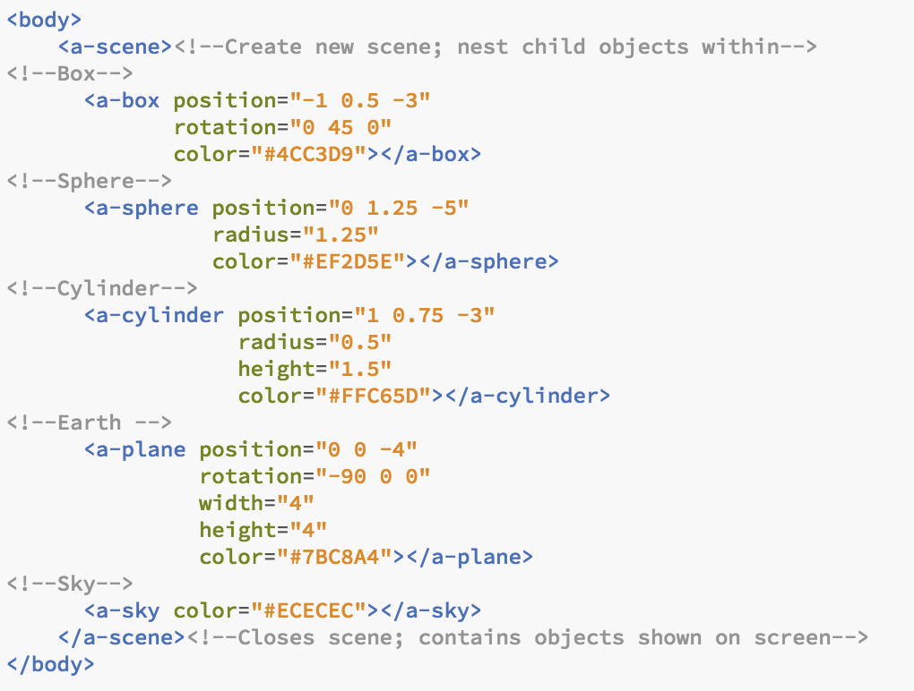
BODY SECTION
The <body> section is where the game assets are defined and placed on the webpage.
Arranged in a hierarchical structure
whatever tag is opened first must close last (stacking dolls)
<a-scene> tag
defines the scene; assets that should be displayed in the scene are included as children of the this tag.

Slide 13
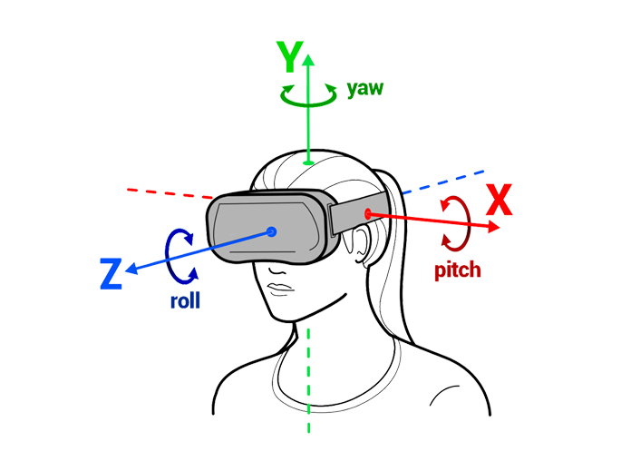
3D POSITIONING
Positioning is defined in a 3D space with a number triplet (x-, y-, and z-coordinates)
This means that (1, 2, 3) corresponds to a position x=1, y=2, z=3.

Slide 14
TUTORIAL PROJECT
Notes:
Reference: Roger Jaffe, PLTW CS Instructor for base of project

Slide 15
INTEGRATION REFLECTION

Slide 16
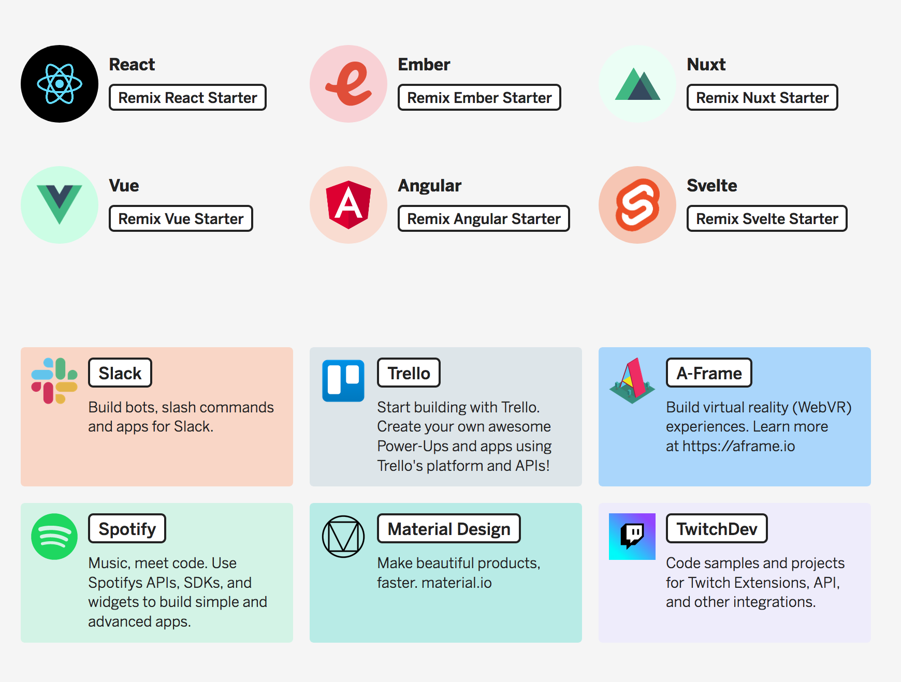
INTEGRATION/ RESOURCES
Cse 1.2 Collaborating around computing
1.2.2 API
Framework
CSP Unit 2 The Internet
2.1.2
2.1.4
Framework
Glitch.com; Many starter Frameworks
A-Frame School; Additional Tutorials
Blender; Object Integration
Google Drive
Controller Interactions

Slide 17
STUDENT BENEFITS
Higher engagement
High Quality Student Work
More creativity
Passion driven projects
Pair Programming
VR Equipment: “Hardware Based” Programming

